Slide 1
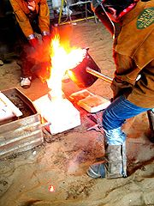
Casting
IC141
Even Semester February-June 2014
Lecture #5
Dr. Mohammad Talha
Asst. Professor
School of Engineering
Indian Institute of Technology Mandi
H.P., INDIA, 175 001
talha@iitmandi.ac.in

Slide 2
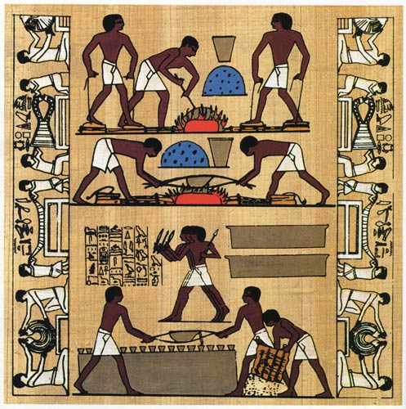
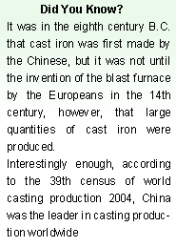
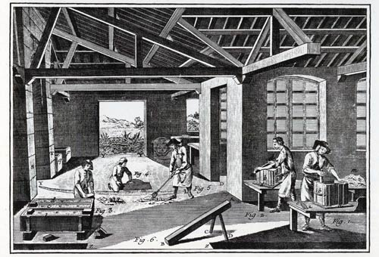

Slide 3
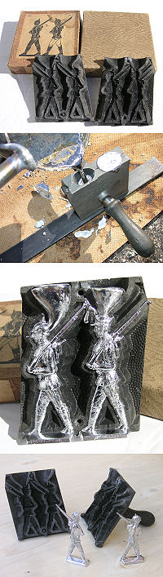
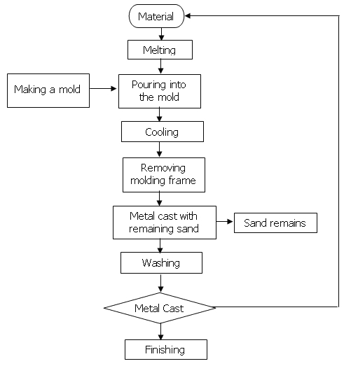

Slide 4
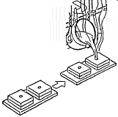



Refractory mold → pour liquid metal → solidify, remove → finish
VERSATILE: complex geometry, internal cavities, hollow sections
VERSATILE: small (~10 grams) → very large parts (~1000 Kg)
ECONOMICAL: little wastage (extra metal is re-used)
ISOTROPIC: cast parts have same properties along all directions

Slide 5
Different Casting Processes
Process | Advantages | Disadvantages | Examples
Sand | many metals, sizes, shapes, cheap | poor finish & tolerance | engine blocks, cylinder heads
Shell mold | better accuracy, finish, higher production rate | limited part size | connecting rods, gear housings
Expendable pattern | Wide range of metals, sizes, shapes | patterns have low strength | cylinder heads, brake components
Plaster mold | complex shapes, good surface finish | non-ferrous metals, low production rate | prototypes of mechanical parts
Ceramic mold | complex shapes, high accuracy, good finish | small sizes | impellers, injection mold tooling
Investment | complex shapes, excellent finish | small parts, expensive | jewellery
Permanent mold | good finish, low porosity, high production rate | Costly mold, simpler shapes only | gears, gear housings
Die | Excellent dimensional accuracy, high production rate | costly dies, small parts, non-ferrous metals | gears, camera bodies, car wheels
Centrifugal | Large cylindrical parts, good quality | Expensive, few shapes | pipes, boilers, flywheels

Slide 6
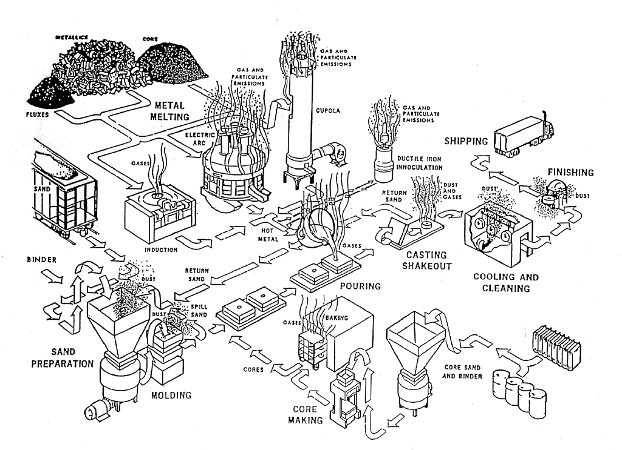
Sand Casting

Slide 7
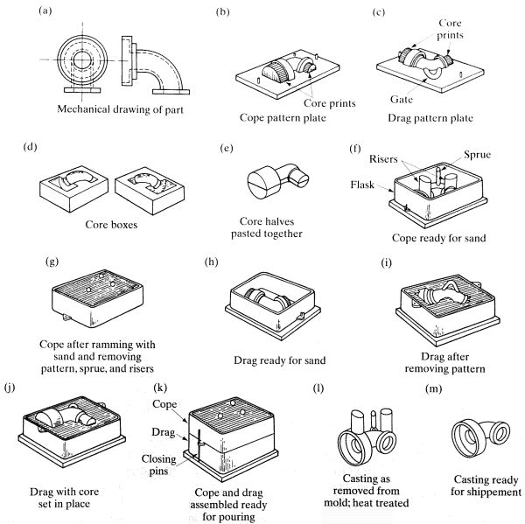
Sand Casting
cope: top half
drag: bottom half
core: for internal cavities
pattern: positive
funnel → sprue →
→ runners → gate →
→ cavity →
→ {risers, vents}

Slide 8
Sand Casting Considerations
(a) How do we make the pattern?
[cut, carve, machine]
(b) Why is the pattern not exactly identical to the part shape?
- pattern → outer surfaces; (inner surfaces: core)
- shrinkage, post-processing
(c) parting line
- how to determine?

Slide 9
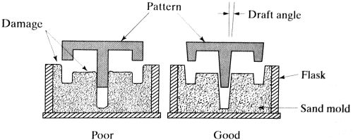
Sand Casting Considerations..
(d) taper
- do we need it ?
(e) core prints, chaplets
- hold the core in position
- chaplet is metal (why?)
(f) cut-off, finishing

Slide 10
Expendable Mold Casting
- foam pattern
- dipped in refractory slurry → dried
- sand (support)
- pour liquid metal
- foam evaporates, metal fills the shell
- cool, solidify
- break shell → part

Slide 11
Plaster-mold, Ceramic-mold casting
Plaster-mold slurry: plaster of paris (CaSO₄), talc, silica flour
Ceramic-mold slurry: silica, powdered Zircon (ZrSiO₄₎
- The slurry forms a shell over the pattern
- Dried in a low temperature oven
- Remove pattern
- Backed by clay (strength), baked (burn-off volatiles)
- cast the metal
- break mold → part
Plaster-mold: good finish (Why ?)
plaster: low conductivity => low warpage, residual stress
low mp metal (Zn, Al, Cu, Mg)
Ceramic-mold: good finish
high mp metals (steel, …) => impeller blades, turbines, …

Slide 12



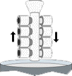



Investment casting (lost wax casting)
(a) Wax pattern
(injection molding)
(b) Multiple patterns
assembled to wax sprue
(c) Shell built →
immerse into ceramic slurry
→ immerse into fine sand
(few layers)
(d) dry ceramic
melt out the wax
fire ceramic (burn wax)
(e) Pour molten metal (gravity)
→ cool, solidify
[Hollow casting:
pouring excess metal before solidification
(f) Break ceramic shell
(vibration or water blasting)
(g) Cut off parts
(high-speed friction saw)
→ finishing (polish)

Slide 13
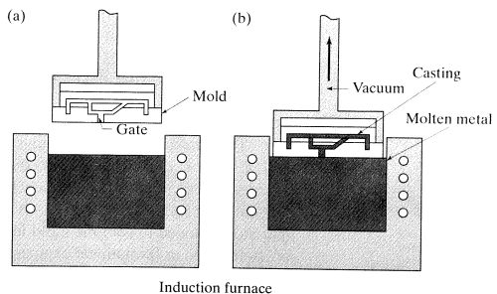
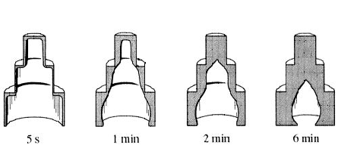
Vacuum casting
Similar to investment casting, except: fill mold by reverse gravity
Easier to make hollow casting: early pour out

Slide 14
Permanent mold casting
MOLD: made of metal (cast iron, steel, refractory alloys)
CORE: (hollow parts)
- metal: core can be extracted from the part
- sand-bonded: core must be destroyed to remove
Mold-surface: coated with refractory material
- Spray with lubricant (graphite, silica)
- improve flow, increase life
- good tolerance, good surface finish
- low mp metals (Cu, Bronze, Al, Mg)

Slide 15
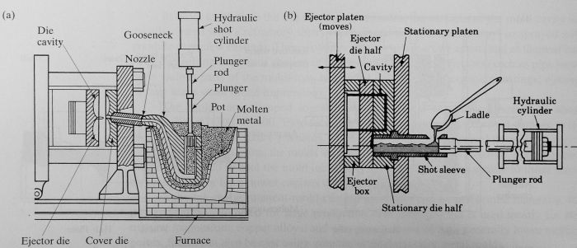
Die casting
- a type of permanent mold casting
- common uses: components for
rice cookers, stoves, fans, washing-,
drying machines,
fridges, motors, toys, hand-tools, car wheels, …
HOT CHAMBER: (low mp e.g. Zn, Pb; non-alloying)
(i) die is closed, gooseneck cylinder is filled with molten metal
(ii) plunger pushes molten metal through gooseneck into cavity
(iii) metal is held under pressure until it solidifies
(iv) die opens, cores retracted; plunger returns
(v) ejector pins push casting out of ejector die
COLD CHAMBER: (high mp e.g. Cu, Al)
(i) die closed, molten metal is ladled into cylinder
(ii) plunger pushes molten metal into die cavity
(iii) metal is held under high pressure until it solidifies
(iv) die opens, plunger pushes solidified slug from the cylinder
(v) cores retracted
(iv) ejector pins push casting off ejector die

Slide 16
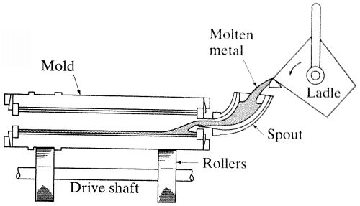
Centrifugal casting
- permanent mold
- rotated about its axis at 300 ~ 3000 rpm
- molten metal is poured
- Surface finish: better along outer diameter than inner,
- Impurities, inclusions, closer to the inner diameter (why ?)

Slide 17
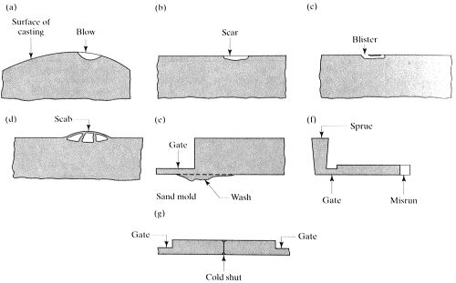
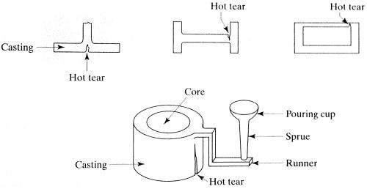
Casting Design: Typical casting defects

Slide 18
Casting Design: Defects and Associated Problems
- Surface defects: finish, stress concentration
- Interior holes, inclusions: stress concentrations

Slide 19
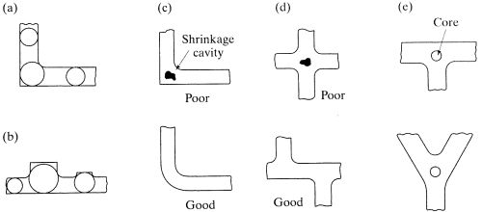
Casting Design: guidelines
(a) avoid sharp corners
(b) use fillets to blend section changes smoothly
(c1) avoid rapid changes in cross-section areas

Slide 20
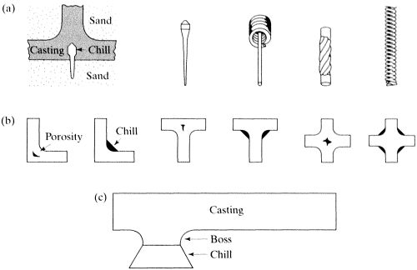
Casting Design: guidelines
(c1) avoid rapid changes in cross-section areas
(c2) if unavoidable, design mold to ensure
- easy metal flow
- uniform, rapid cooling (use chills, fluid-cooled tubes)

Slide 21
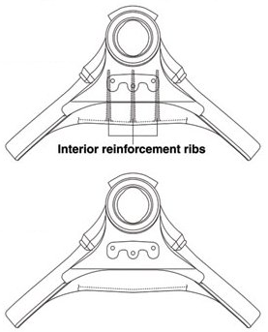
Casting Design: guidelines
(d) avoid large, flat areas
- warpage due to residual stresses (why?)

Slide 22
Casting Design: guidelines
(e) provide drafts and tapers
- easy removal, avoid damage
- along what direction should we taper ?

Slide 23
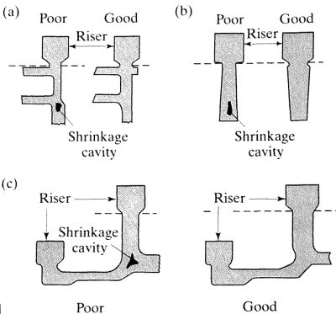
Casting Design: guidelines
(f) account for shrinkage
- geometry
- shrinkage cavities

Slide 24
Lecture presented herein are taken from different sources
like Internet, books, etc.
End of lecture #5

